Slide 1
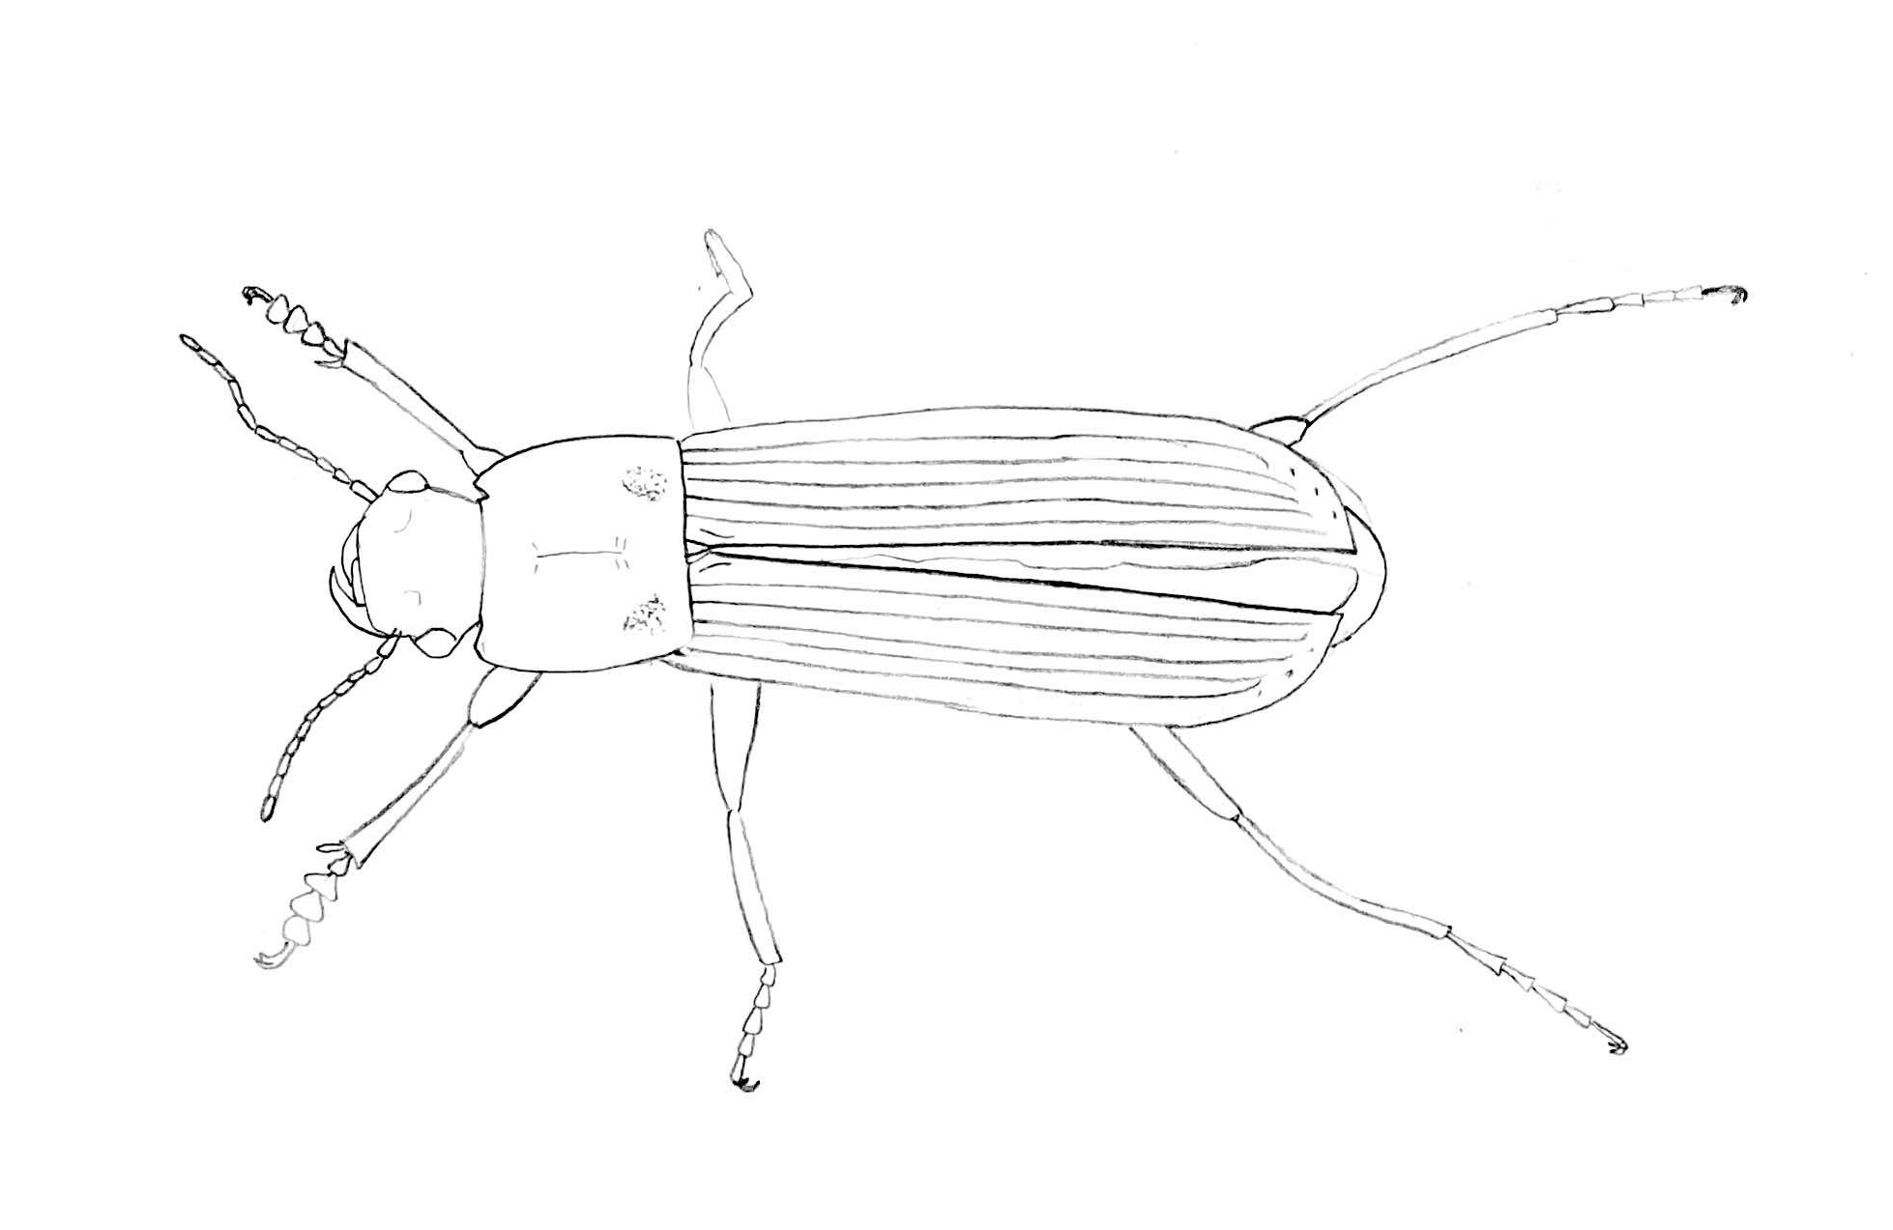
e
h
w
a
f
t

Slide 2
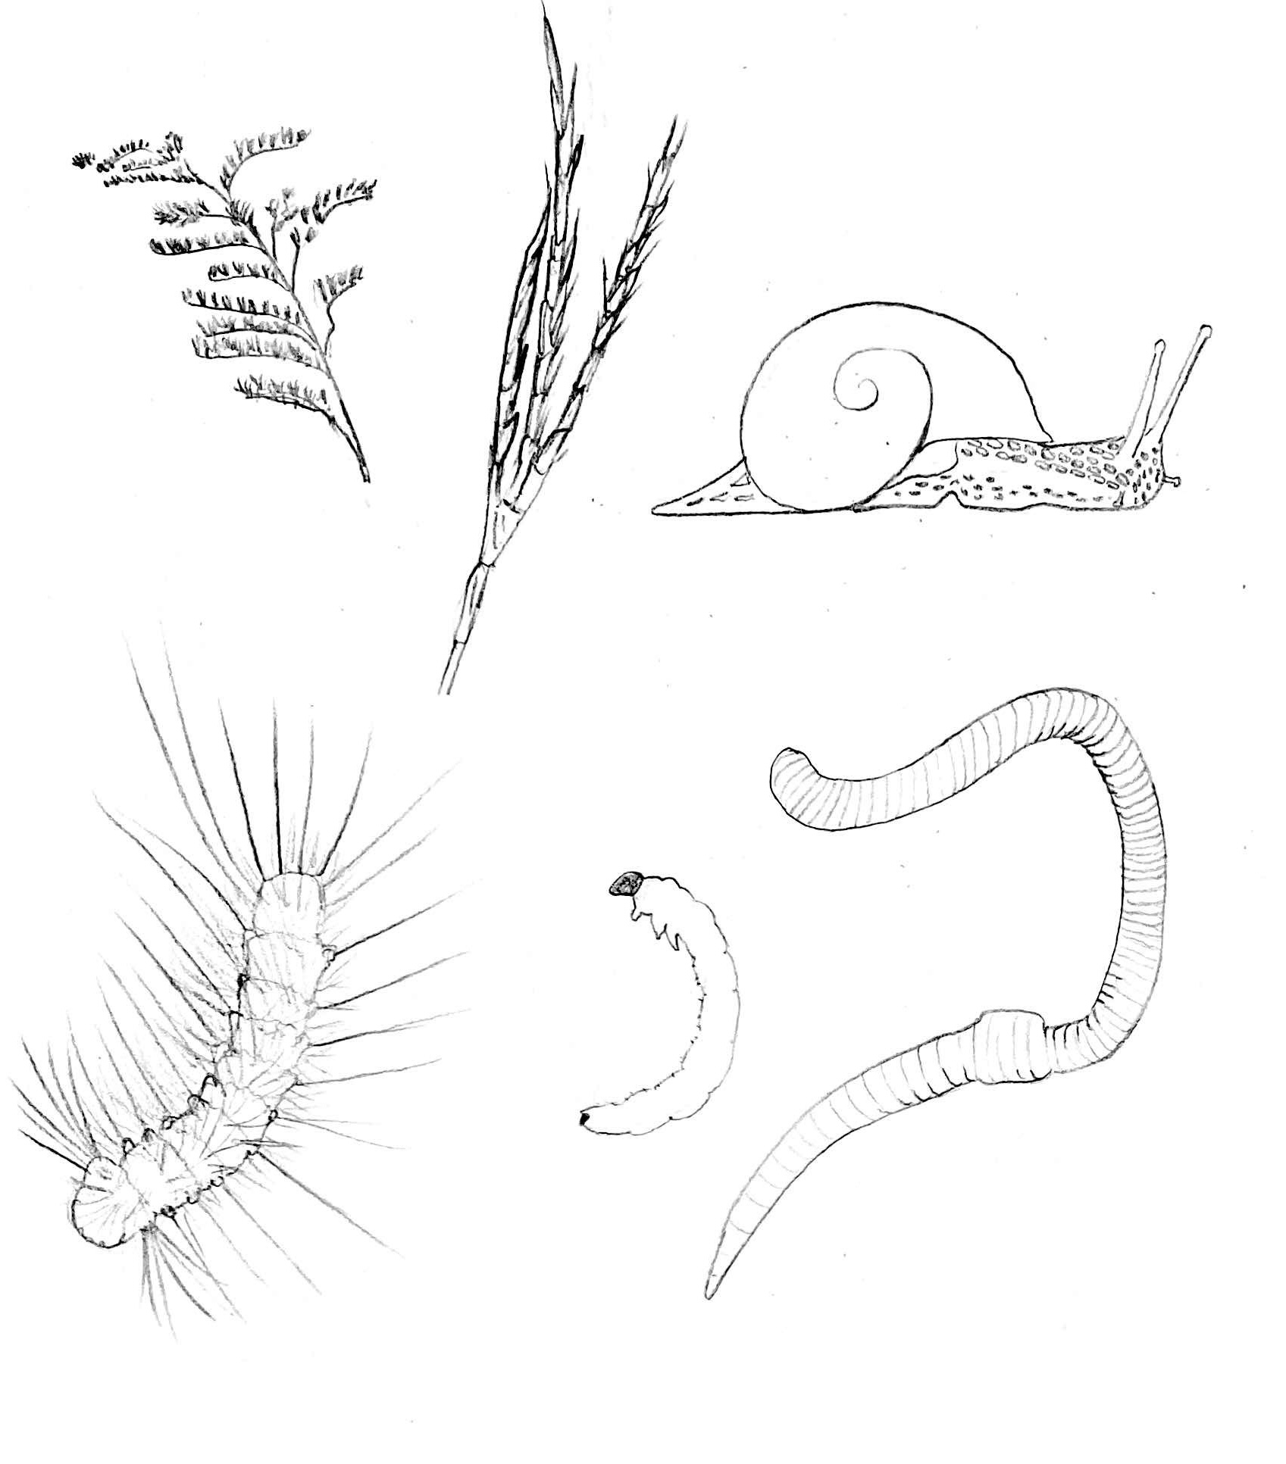
plant seeds
gastropods
annelids
beetle larvae
caterpillars

